Slide 1
Lecture 10
CS494 – Information System Audit and Control
29th April 2023

Slide 2

Chapter 4
Information Systems Operations and Business Resilience

Slide 3
What will we learn in this chapter?
Scope of IT operations
How to keep IT operations up and running
How to evaluate each and every aspect of IT operations
How IT can effectively tackle disasters and ensure business resilience
This chapter is unstructured – we will jump from concept to concept. No natural flow.

Slide 4
Job Scheduling and Production process automation
A job schedule is a program that is used to run various processes automatically. What is this called in windows?
Why would organizations need job scheduling / batch processing?
While scheduling jobs, it is important to give optimum resource availability to high-priority jobs.
E.g Oracle Fusion processing / Veeam Backup and Replication

Slide 5
System interfaces / Middleware?
System interfaces provide the ability to transfer data between multiple systems, even if the systems use different programming languages or were created by different developers.
These interfaces require thorough checks and balances to ensure data is properly transferred and updated in all systems.
Exception log files are required to capture irregularities.
E.g. Oracle Fusion capabilities / RPA

Slide 6
Data Governance

Slide 7
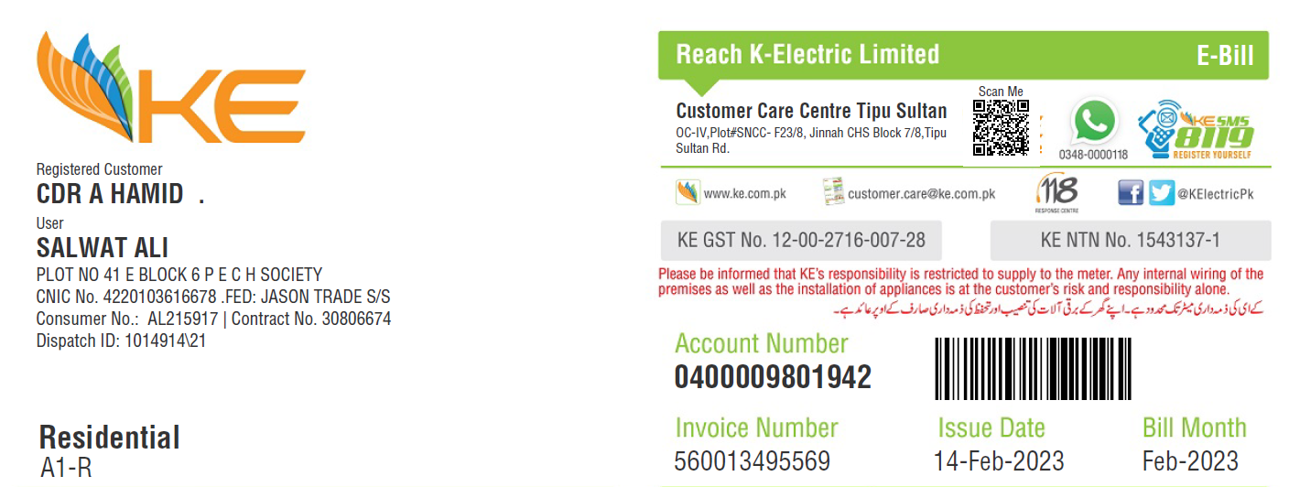
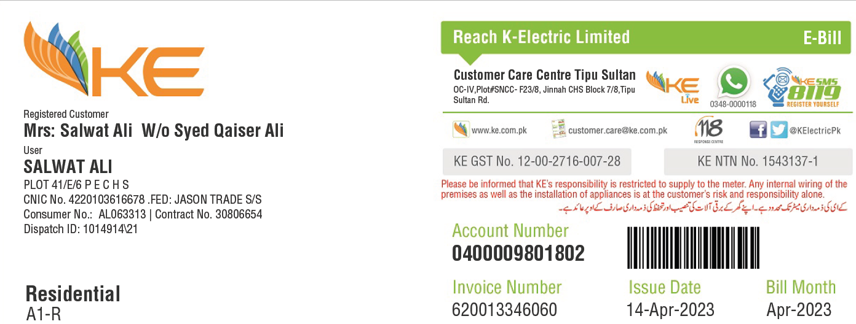
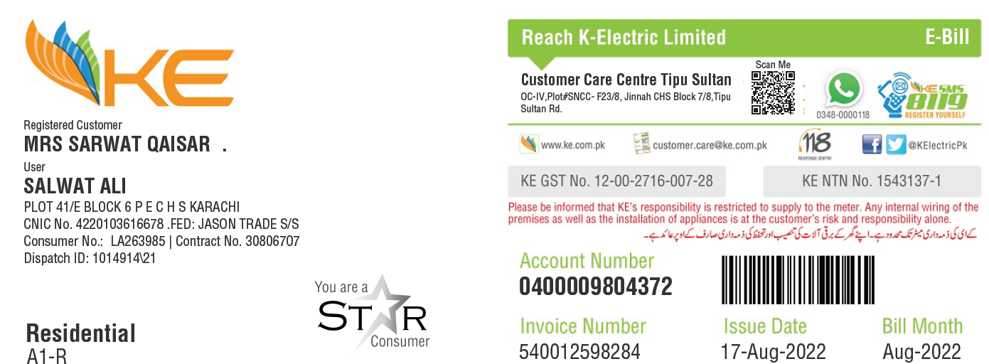
No concept of account linking – Master account
Single change updates all
Address is not standardized
All three bills are three different homes

Slide 8
Data Governance
IT Governance ?
Data governance is a necessary methodology that allows organizations to take control over their data by imposing rigorous standards, procedures and regulations concerning data ownership and usage.
It involves establishing policies, procedures, and standards for data management, ensuring compliance with regulations, and assigning roles and responsibilities for data-related activities.

Slide 9
Data Governance
Data governance helps answer questions like:
Who has ownership of the data?
Who can access what data?
Is the data we store accurate and reliable?
What security measures are in place to protect data and privacy?
How much of our data is compliant with new regulations?
Which data sources are approved to use?

Slide 10
Data Governance
The primary goals of data governance are to achieve better regulatory compliance, higher data quality that is more suited for data analytics, and to help ensure first-rate business decisions
By implementing effective data governance practices, organizations can ensure that their data is used in a responsible and ethical manner, and that they comply with legal and regulatory requirements.

Slide 11
Data Governance
GDPR requires explicit consent of users before collecting their personal data
To comply with these requirements, an organization might establish a data governance framework that includes policies and procedures for data collection, processing, storage, and sharing.
This might involve appointing a data protection officer to oversee data governance, conducting regular audits of data handling practices, and implementing technical measures such as encryption and access controls to ensure data security.

Slide 12
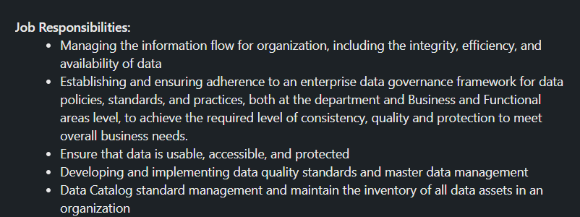
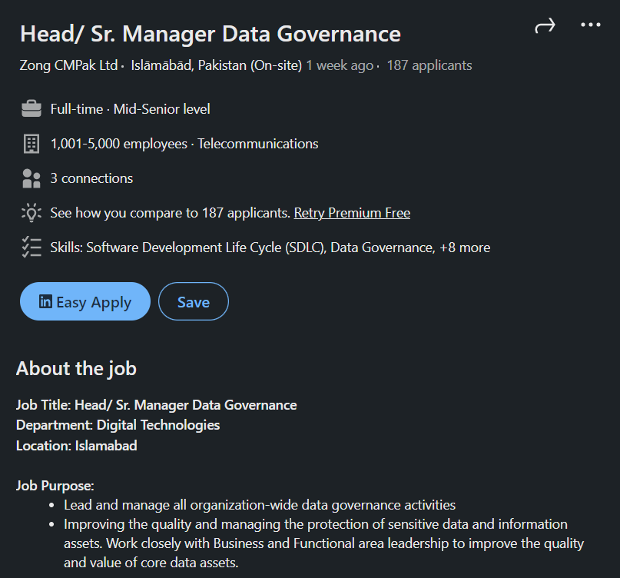
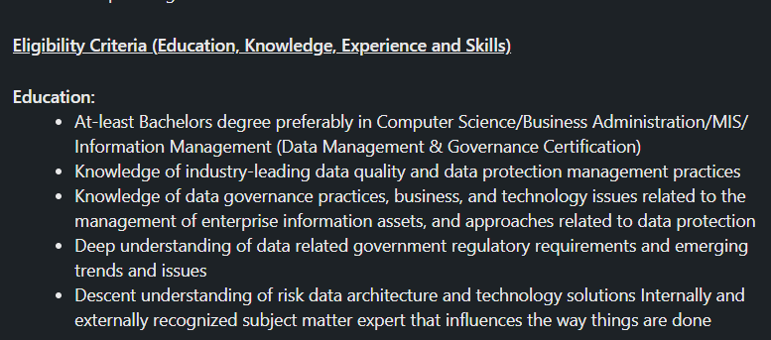

Slide 13
Data Management
IT Management?
Data management is focused on the technical aspects of data, ensuring that data is organized, accessible, and usable for its intended purpose.
Data management refers to the processes, technologies, and practices used to collect, store, organize, maintain, and use data.
It includes activities such as data modeling, data integration, data warehousing, data mining, and data analytics.

Slide 14
Data Management vs Data Governance
Data Governance is like setting up rules and regulations for how data should be handled within an organization. It's about making sure that everyone who deals with data follows the same guidelines and standards. Just like how traffic laws help ensure safe driving, data governance ensures that data is used, stored, and shared in a way that's secure, accurate, and complies with any legal or ethical requirements.
On the other hand, Data Management is more about the practical side of things. It's like the day-to-day operations of handling data - organizing it, storing it, cleaning it up, and making sure it's available when needed. Data management involves tasks like creating databases, backing up data, and ensuring that information is easily accessible to those who need it.
To put it simply, data governance is the "what" and "why" of managing data, while data management is the "how."

Slide 15
Software Licensing
Software copyright laws must be followed to protect against the possibility of a company paying penalties over copyright infringements and the added reputational risk of being identified as a company that illegally uses software.
Software licensing types:
1. Open source - This software can be listed, modified and redistributed as required. However, this should be done in accordance with terms and conditions mentioned in the software license.

Slide 16
Software Licensing
2. Freeware - Software is free but source code cannot be redistributed. For example: Adobe Reader.
3. Shareware - Some softwares are available for free for some trial period and has limited functionality as compared to the full version

Slide 17
Paid software licensing
Per seat (no. of users)
Per CPU / Sockets (Oracle / VM licensing)
Concurrent users
Per workstation
Enterprise licensing
IS auditors would be expected to check licensing violations by matching actual usage vs allowed usage.

Slide 18
Ways to avoid software licensing misuse
Ensure a good software asset management process exists
Centralize control, distribution and installation of software (includes disabling the ability of users to install software, where possible).
Require that all PCs be restricted workstations with disabled or locked down disk drives, USB ports, etc.
Install metering software on the LAN and require that all PCs access applications through the metered software.
Regularly scan user networks endpoints to ensure that unauthorized copies of software have not been loaded (achieved by comparing actual software loaded to the list of software assets)

Slide 19
An auditor sees certain indications that an organization is using unlicensed software. What should be the auditor’s first step?
1. Report the indications in the audit report
2. Verifying the software through testing
3. Discuss the issue with auditee management
4. Recommend the immediate uninstallation of the software

Slide 20
An IS auditor notes that some users have installed personal software on their PCs. There is no restriction by security policy. What is the best recommendation for the auditor to make?
1. Implement necessary controls to restrict the installation of unauthorized software
2. To include a clause related to the restriction of unauthorized software in the security policy
3. Restrict the downloading of unauthorized software
4. Allow users to install software only after IT manager approval

Slide 21
Which of the following is the greatest concern for the use of open source software?
1. No payment is made to acquire open source software.
2. An organization must comply with open source software license terms.
3. Open source software is vulnerable.
4. Open source software is not reliable

Slide 22
Source Code Management
Version Controlling should be in place to manage source code changes.
Regular backups of source code should be taken
Escrow in place.

Slide 23
Capacity Management
Capacity management is the process of planning and monitoring IT resources for their effective and efficient utilization.
It ensures the smooth expansion or reduction of resources as per business requirements.
It is necessary to obtain inputs from business users in order to manage capacity.
It reduces the risk of performance problems or failure through the constant monitoring of utilization thresholds.

Slide 24
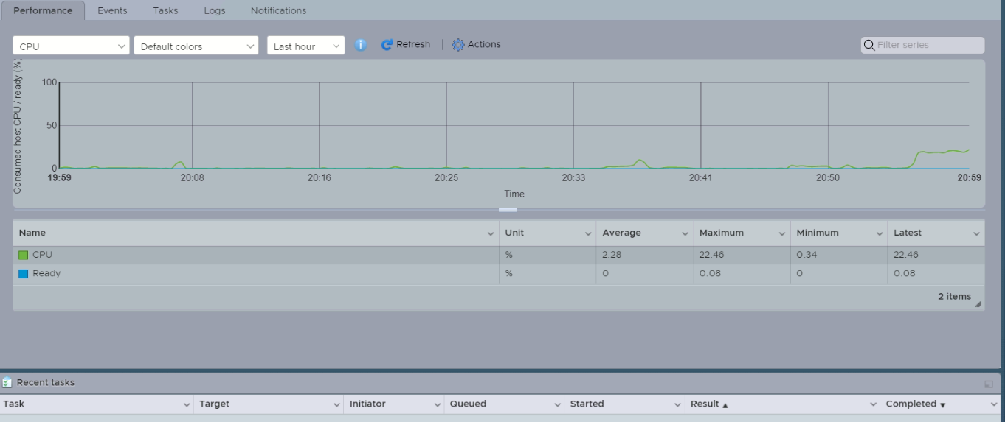

Slide 25
How can the optimal configuration of a server be ensured?
1. Benchmarking with industry standards
2. Log capturing
3. Server utilization reports
4. Network protocol reports

Slide 26
Problem and Incident Management
Expect a question in the final. These are very important concepts to understand
Problem Management
Problem management aims to resolve issues through the investigation and in-depth analysis of a major incident or several incidents that are similar in nature to identify the root cause.
Techniques for problem solving –e.g. 5 why’s

Slide 27
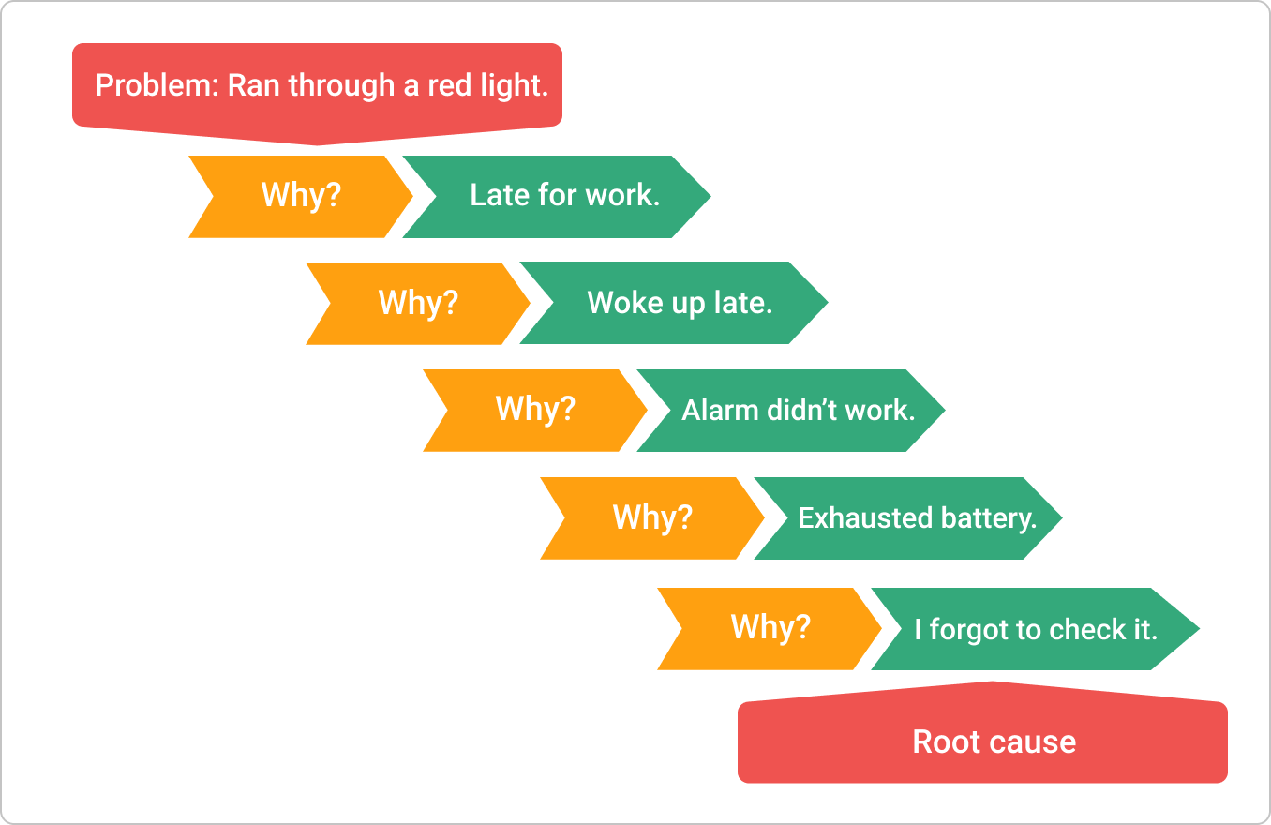
5 Why example

Slide 28
Problem and Incident Management
After a problem is identified and analysis has identified a root cause, the condition becomes a known error
A workaround can then be developed to address the error state and prevent future occurrences of the related incidents.
The objective of problem management is to prevent the recurrence of an incident by identifying the root cause of the incident and taking appropriate preventive action.

Slide 29
Problem and Incident Management
Incident Management
Incident management is achieving a return to a normal state as quickly as possible after an incident and thus minimizing the impact on the business.
Lets do an example of Problem and Incident Management.

Slide 30
Situation
Imagine you are part of an IT support team for a medium-sized company. One morning, several employees report that they are unable to access their email accounts. Upon investigation, you discover that the email server is experiencing a service outage, causing disruption to business operations.
What should be the first course of action?
How do we understand the root cause?
How to manage incident vs how to solve problem?

Slide 31
Problem and Incident Management
The primary risk of a lack of attention to problem management is the interruption of business operations.
An IS auditor should review problem reports and logs to ensure that problems are addressed in a time-bound manner.
Problems are solved – Incidents are managed.

